Slide 1

Edge Assisted Mobile Semantic Visual SLAM
Jingao Xu*, Hao Cao*, Danyang Li*, Kehong Huang*, Chen Qian†
Longfei Shangguan‡, Zheng Yang*
*School of Software and BNRist, Tsinghua University
† Dalian University of Technology
‡ Microsoft
July 9, Online
Notes:
[START]Hello everyone, I’m Jingao from Tsinghua University, I’m now a PhD candidate under the supervision of professor Zheng Yang and Yunhao Liu.
Today, I’ll talk about our recent work : “Edge assisted mobile semantic visual SLAM”, an edge assisted framework that enable mobile devices to run visual semantic SLAM in real-time.

Slide 2
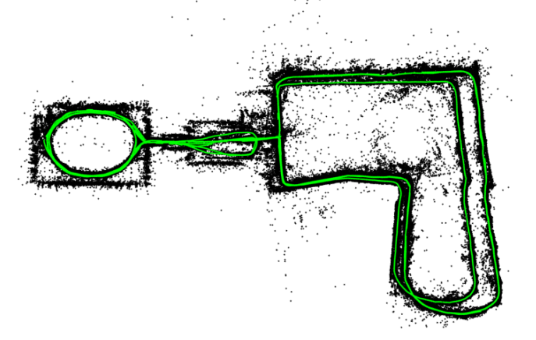
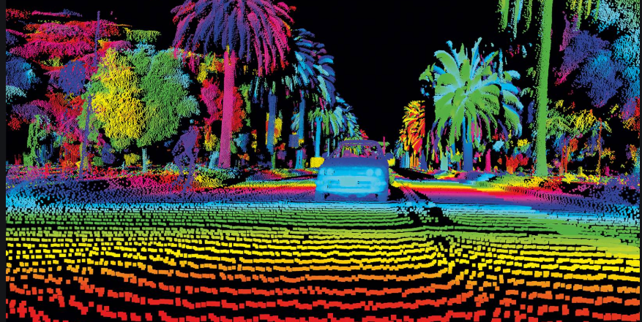
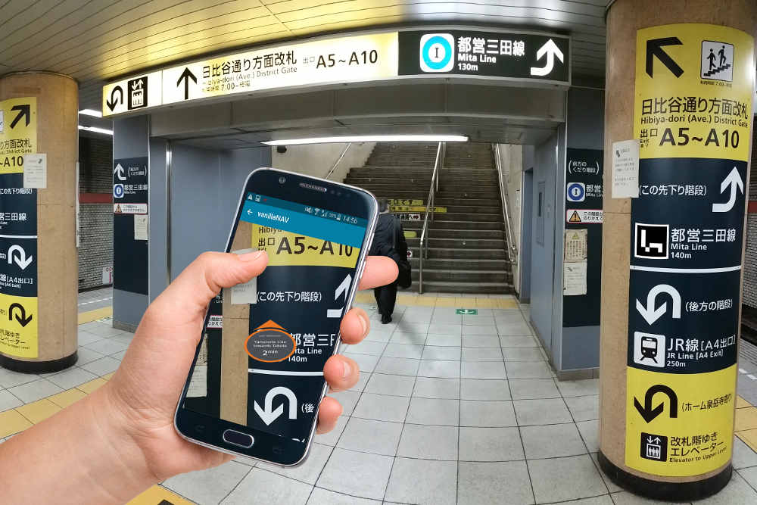
Motivation
What is SLAM?
Simultaneous Localization And Mapping
Why visual SLAM?
Ubiquitous: Almost each smart mobile device has been equipped with camera.
Low-cost: Off-the-shelf monocular camera compared with expensive sensor (e.g. Lidar).
High-accuracy: Localization bias of state-of-the-art SLAM framework(ORB-SLAM) is within 10cm.
UAV Environment Reconstruction
Autopilot
Robot/Human Navigation
Notes:
[START]The proliferation of various location-based ubiquitous applications fosters the demand for accurate localization and navigation services.
Among various approaches, visual SLAM based methods have hit the mainstream in recent years.
SLAM which means Simultaneous Localization And Mapping, will calculate the pose of camera, at the meantime reconstruct the surrounding environment
Nowdays, SLAM have been used in many scenarios, such as UAV, autopilot and indoor robot or human navigation.
[CLICK]Among them, image based visual SLAM has become the most attractive kind of SLAM framework for commercial mobile devices, because of the ubiquitous, low-cost and high accuracy.
For example, almost each smart mobile device has been equipped with at least one camera.
And compared with lidar or FMCW sensor, the cost for camera is very cheap.
And visual SLAM has a relative high accuracy, for example, the localization bias of state of the art visual SLAM framework like ORB SLAM is within 10cm

Slide 3
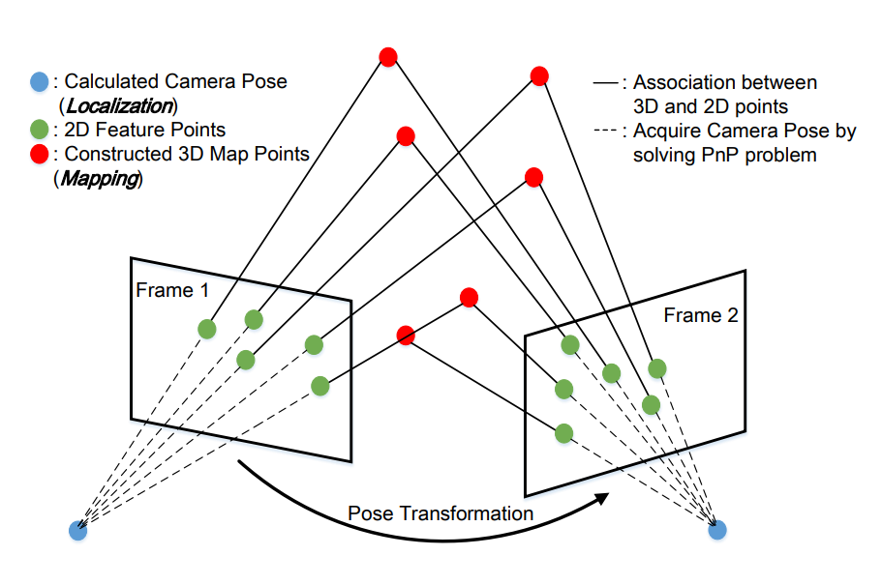
Motivation
What is SLAM?
Simultaneous Localization And Mapping
Notes:
Let me brief introduce the principle of visual SLAM.
Just as shown in the figure, when a new video frame arrives (for example frame 2), the visual SLAM module will extract its 2D feature points and associate them with 3D map points in storage. the 2D-to-3D feature points matching will give us a rough camera pose on the current frame.

Slide 4
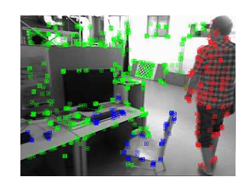
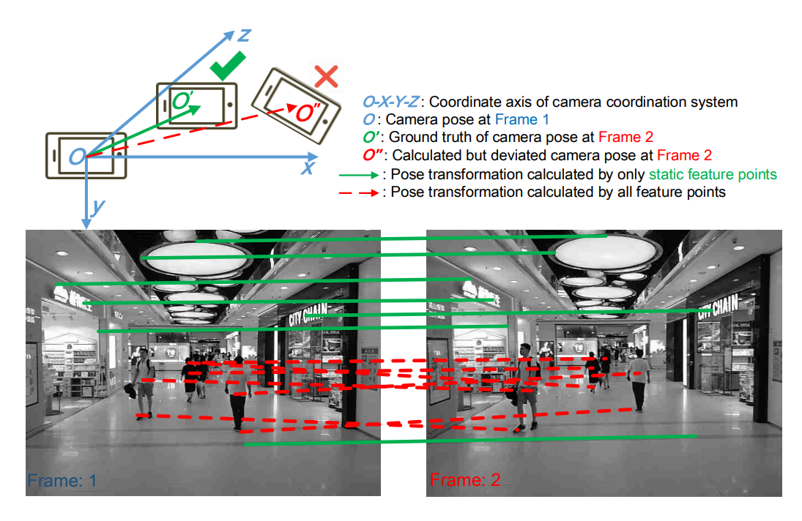
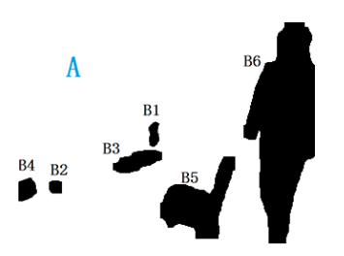
Motivation
Challenges of Visual SLAM
Environmental dynamic
Fusing SLAM with
Semantic Segmentation
Notes:
[START]However, blindly applying visual SLAM to mobile scenarios may not achieve good performance because of highly dynamic environmental changes, such as customs in shopping mall.
Just as shown in the figure, the feature points on the red dotted line are associated to dynamic customs. Taking these dynamic points into calculation will harm the result of the camera pose.
To solve this problem, some recent works combine SLAM with semantic segmentation techniques like Faster RCNN or Mask RCNN.
The segmentation framework will help to delete feature points lies in dynamic objects and further enhance the robustness of SLAM.

Slide 5
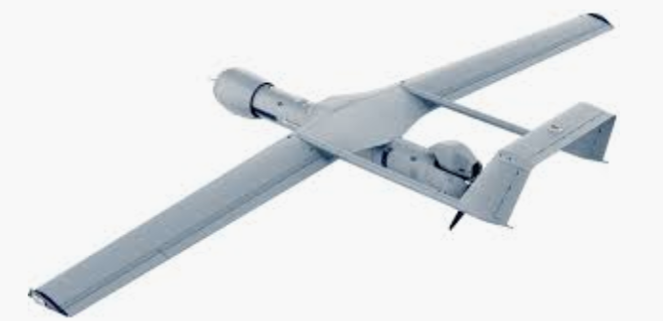
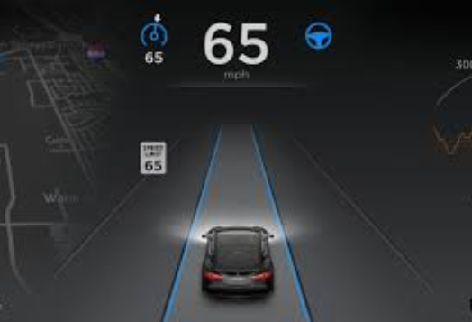
Motivation
Challenges of Visual SLAM
Environmental dynamic
Limited computational resource
Operation time for each frame | Google Nexus 6p | Samsung Galaxy S10 | Apple iPhone X | Nvidia Jetson TX2 | Comments
ORB SLAM[1] | 57ms | 50ms | 43ms | 31ms | Cannot run in real-time (>30 fps)
Mask RCNN[2] | 7300ms | 6300ms | 3400ms | 2100ms | Cannot work on commercial mobile devices
[1] R. Mur-Artal and J. D. Tardos, “ORB-SLAM2: an open-source SLAM system for monocular, stereo and RGB-D cameras,” IEEE Transactions on Robotics, vol. 33, no. 5, pp. 1255–1262, 2017
[2] K. He, G. Gkioxari, P. Dollar, and R. Girshick, “Mask r-cnn,” in ´ Proceedings of the IEEE ICCV, 2017
Notes:
[START] While the evolving hardware and software of mobile devices (e.g., the latest Samsung Galaxy S10 smartphone is equipped with three HD cameras) guarantees the image quality for fine-grained visual SLAM,
[CLICK]the computational resource on mobile devices, unfortunately, is still insufficient to meet the visual SLAM’s ever-growing computation demand.
For example, as we experimentally demonstrated, even ORB-SLAM , a light-weight, functional-constrained visual SLAM algorithm, still cannot work in real-time (i.e., ≤30 fps) on the latest smartphone
As for Mask RCNN, none of recent mobile devices can infer one frame within 2s.
[CLICK] Nowdays, maybe only the expensive UAV and autopilot can run visual SLAM in real-time.

Slide 6
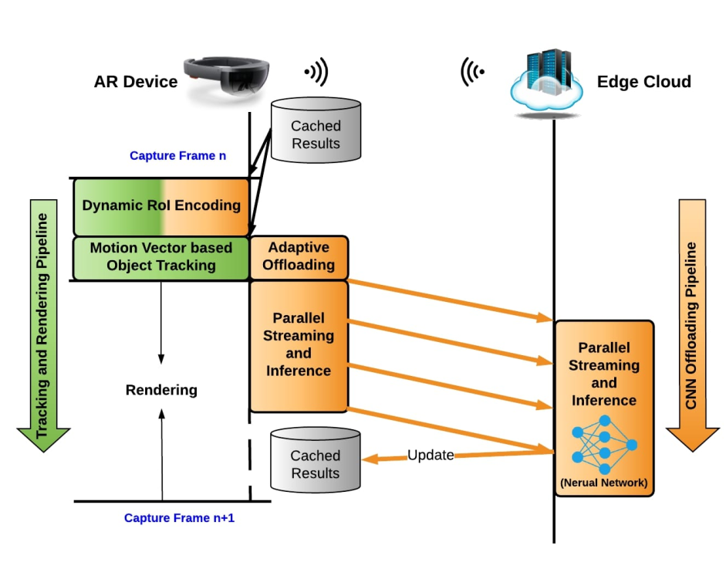
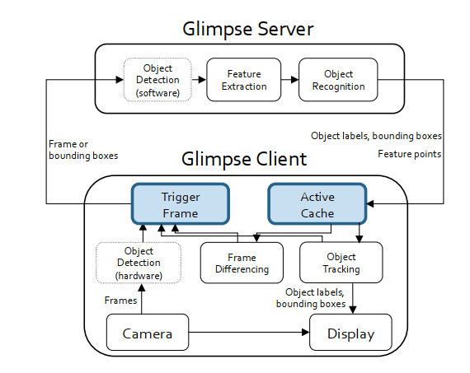
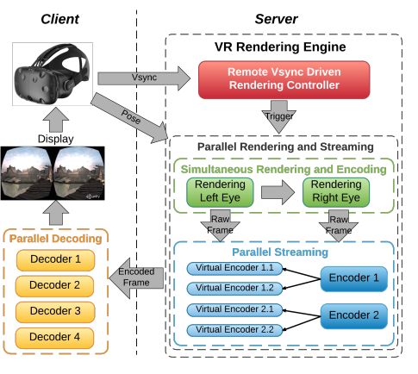
Key Insight
Leverage the emerging paradigm of edge computing
Speed up semantic visual SLAM by offloading partial workload to an edge server
EdgeAR Mobicom’19
Glimpse Sensys’18
EdgeVR Mobisys’18
Notes:
[START]Recent years, the emerging paradigm of edge computing, is powerful for solving computation-intensive tasks locally and in real-time.
[CLICK]Many recent works leverage the paradigm and design efficient offloading strategy between mobile client and edge server to speed up computational complicated tasks. Like AR VR and object detection on mobile devices.
So, it’s intuitive for us to think, can we leverage the edge assisted paradigm to make semantic visual SLAM feasible on commercial mobile devices?

Slide 7
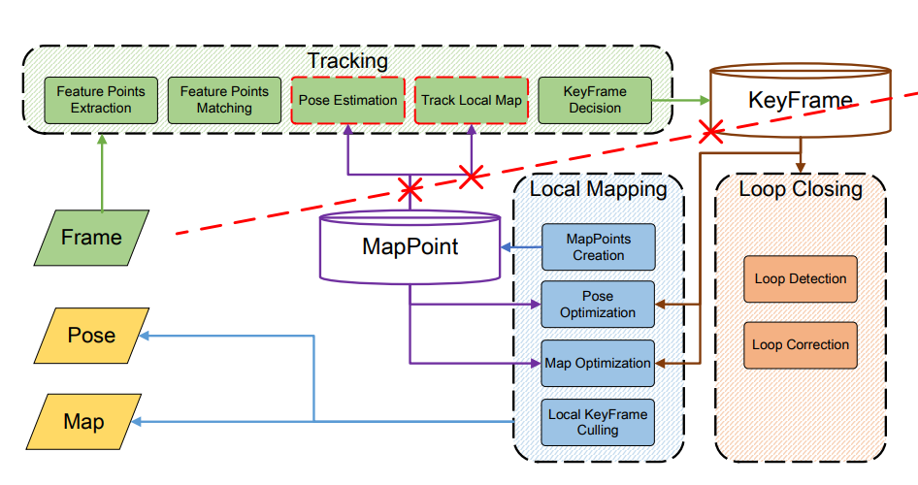
Challenge
Leverage the emerging paradigm of edge computing meets three major challenges:
Task decomposition
To much
database-dependency
functional units
Notes:
[START]The answer is Yes, and it is what we did in our work.
However, realizing this intuition is non-trivial and faces three major challenges.
[CLICK]First, task decomposition.
Partitioning both visual SLAM algorithm and semantic segmentation algorithm into unit tasks, however, is also non-trivial as both of their functional units are tightly coupled. As shown in the figure, an improper partition may result in redundant(瑞丹den 特) data storage, exchange, and most importantly, system delay, which definitely in turn increases the system latency.

Slide 8
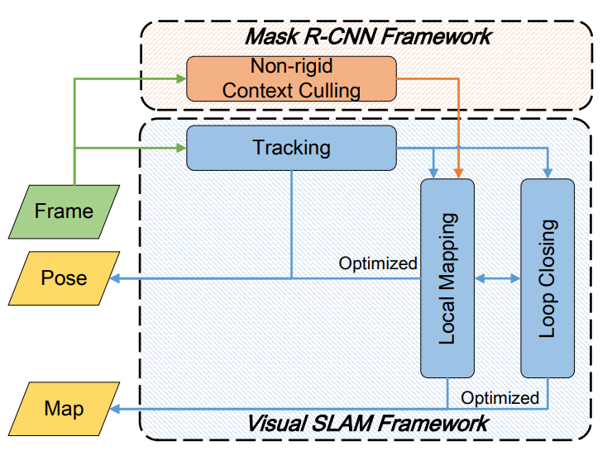
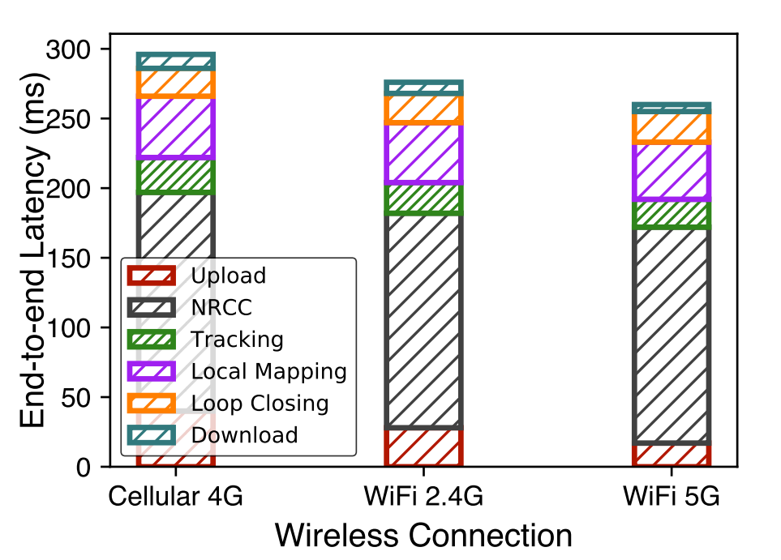
Challenge
Leverage the emerging paradigm of edge computing meets three major challenges:
Task decomposition
Task cooperation
They are regarded as
two independent tasks
Notes:
[START]Second, task cooperation.
The visual SLAM and semantic segmentation algorithms are generally regarded as two independent tasks, without the reuse of intermediate results.
However, to achieve both low-latency and high accuracy, it is beneficial to share the intermediate results between these two algorithms so that redundant computations can be eliminated or minimized.

Slide 9
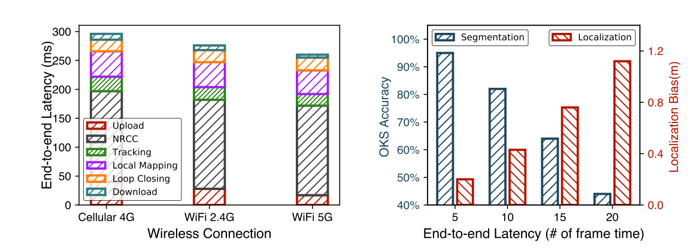
Challenge
Leverage the emerging paradigm of edge computing meets three major challenges:
Task decomposition
Task cooperation
Task scheduling
Notes:
[START]The last but not the least,
[CLICK] task scheduling.
Simply transmitting all images back to an edge server is not feasible since it will introduces excessive bandwidth cost and transmission delays. Just the transmission delay will lead to large localization bias.
Meanwhile the wireless link between these two parts also varies from time to time. Task scheduling strategy should be adaptive to the dynamics in computation resource and wireless link quality

Slide 10
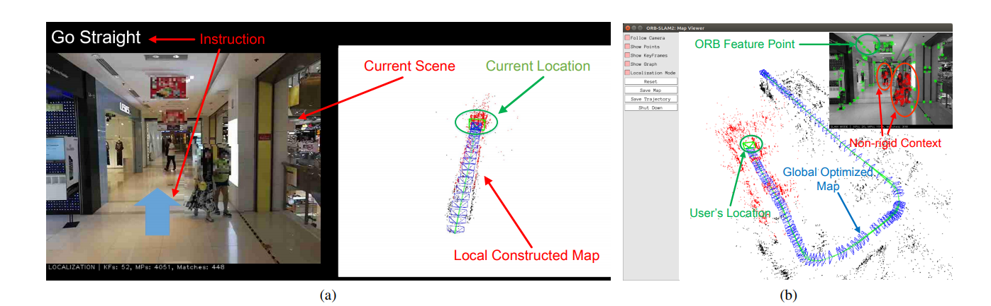
Our System
Edge Assisted Mobile Semantic Visual SLAM
Real-time on mobile device
Navigation with semantic information
High localization accuracy
Mobile Client
Edge Server
Notes:
[START] In this paper we solve the above three challenges and design edgeSLAM, a real-time edge assisted semantic visual SLAM service running on commercial mobile devices.
edgeSLAM leverages the state-of-the-art semantic segmentation algorithm Mask-RCNN to improve SLAM accuracy and speed up the SLAM and semantic segmentation algorithm by efficient computation offloading and data sharing,
The user interface of edgeSLAM is presented in the figure.
From mobile part: Navigation instruction and local constructed map are displayed on mobile device. For user to navigation
From edge server part: Optimized global map and user’s location are displayed.

Slide 11
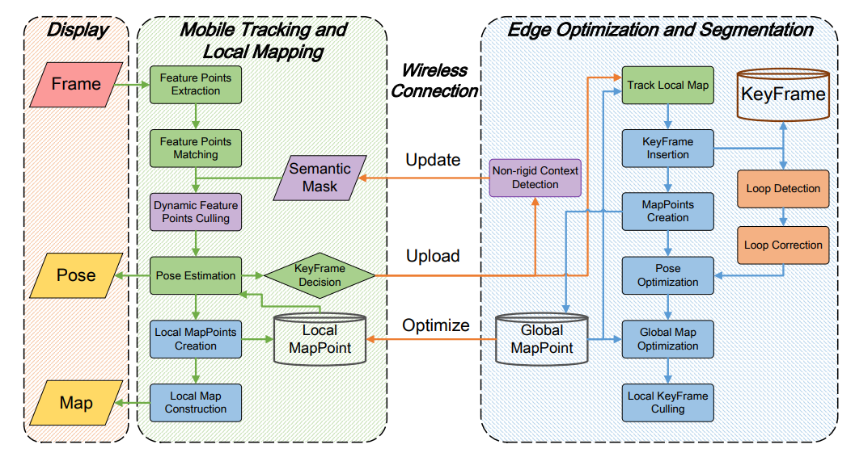
System Overview
1. Decouple two frameworks into fine-grained modules and re-design them
2.Deeply fused
SLAM
and
Segmentation
frameworks
3. Dynamic KeyFrame selection strategy with respect to wireless connection condition
Notes:
[START]This is the system overview of edgeSLAM. The delightful performance of edgeSLAM lies in our three designs:
[CLICK]We decouple two frameworks into fine-grained modules and re-design them between mobile client and edge server.
[CLICK]We make SLAM and Segmentation framework deep fused, these two sub-systems will share intermediate result.
[CLICK]We design dynamic keyframe selection strategy with respect to wireless connection condition. Only keyframe will be uploaded to edge server for optimization.
In the following, I will brief introduce the three major parts of edgeSLAM, for better understanding, please reference to our article.

Slide 12
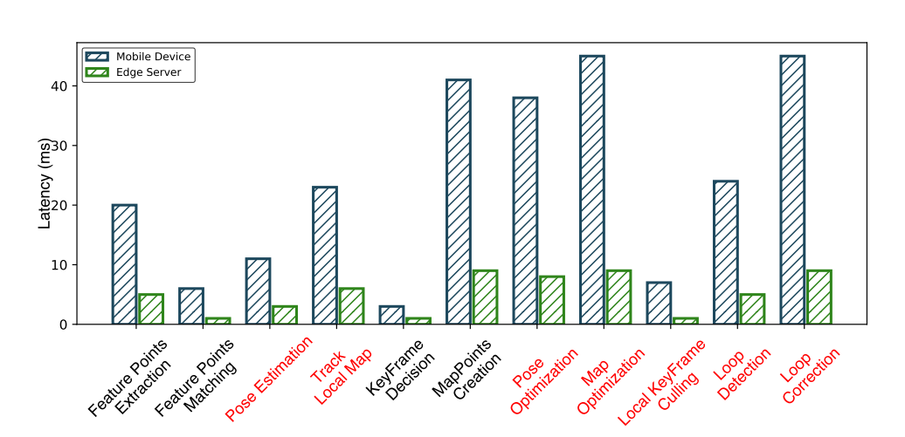
Our System
Decouple two frameworks into fine-grained modules and re-design them
Measure operation latency of each function unit in visual SLAM on mobile client and edge server.
Graph-based re-design strategy, taking operation latency, memory overhead, and database-dependency into consideration.
Notes:
[START]To decouple two framworks into fine-grained modules and re-design them,
We measure operation latency of each module on both mobile clien and edge server, as shown in the figure.
And we design a graph-based strategy to partition the whole system between client and edge.
The graph-based strategy take operation latency, memory overhead, and database-dependency into consideration.
For more details, please reference to our paper.

Slide 13
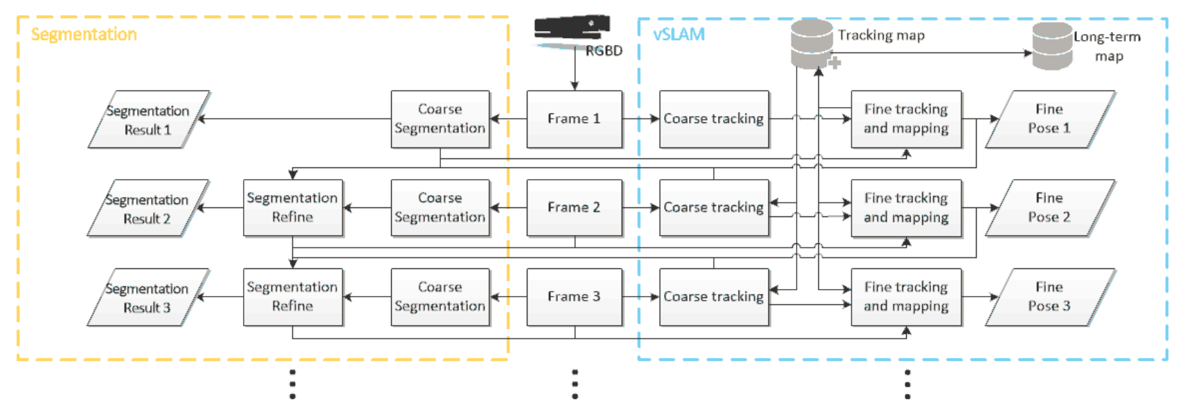
Our System
Deeply fused SLAM and Segmentation frameworks
A unified framework of enhancing the SLAM and segmentation tasks mutually
Notes:
[START]We also design a unified framework of enhancing the SLAM and segmentation tasks mutually. For each input frame, a coarse pose and segmentation are first calculated. The two results are then used to estimate a fine pose and update a tracking map. A long-term map is also maintained for the further visit of the same area. At the same time, the segmentation results can also be refined by using that of the previous frame and the poses estimated in the two frames. The refinement of the vSLAM and segmentation results is implemented within a single iteration for each frame

Slide 14
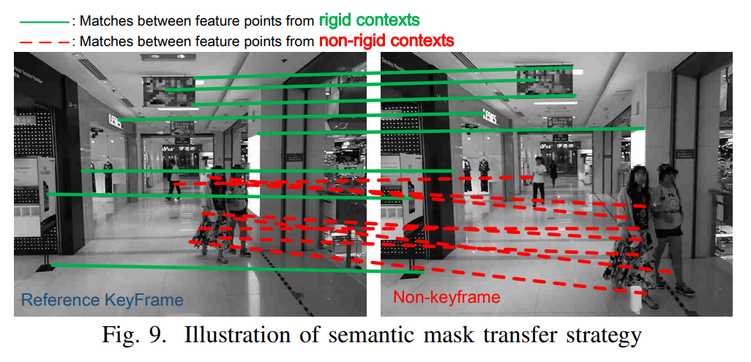
Our System
Deeply fused SLAM and Segmentation frameworks
A unified framework of enhancing the SLAM and segmentation tasks mutually
Mask transfer strategy
Notes:
[START]
We adapt a mask transfer strategy, just as shown in the figure, the mask layer can be transferred according to the feature points matching result.
On the bias of that, only some keyframes will need to be uploaded to infer semantic segmentation.

Slide 15
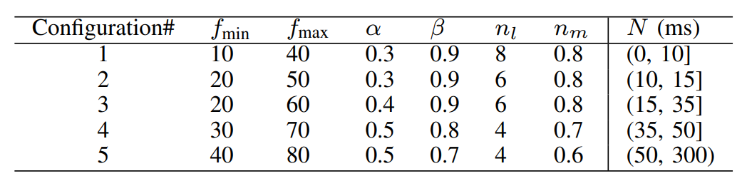
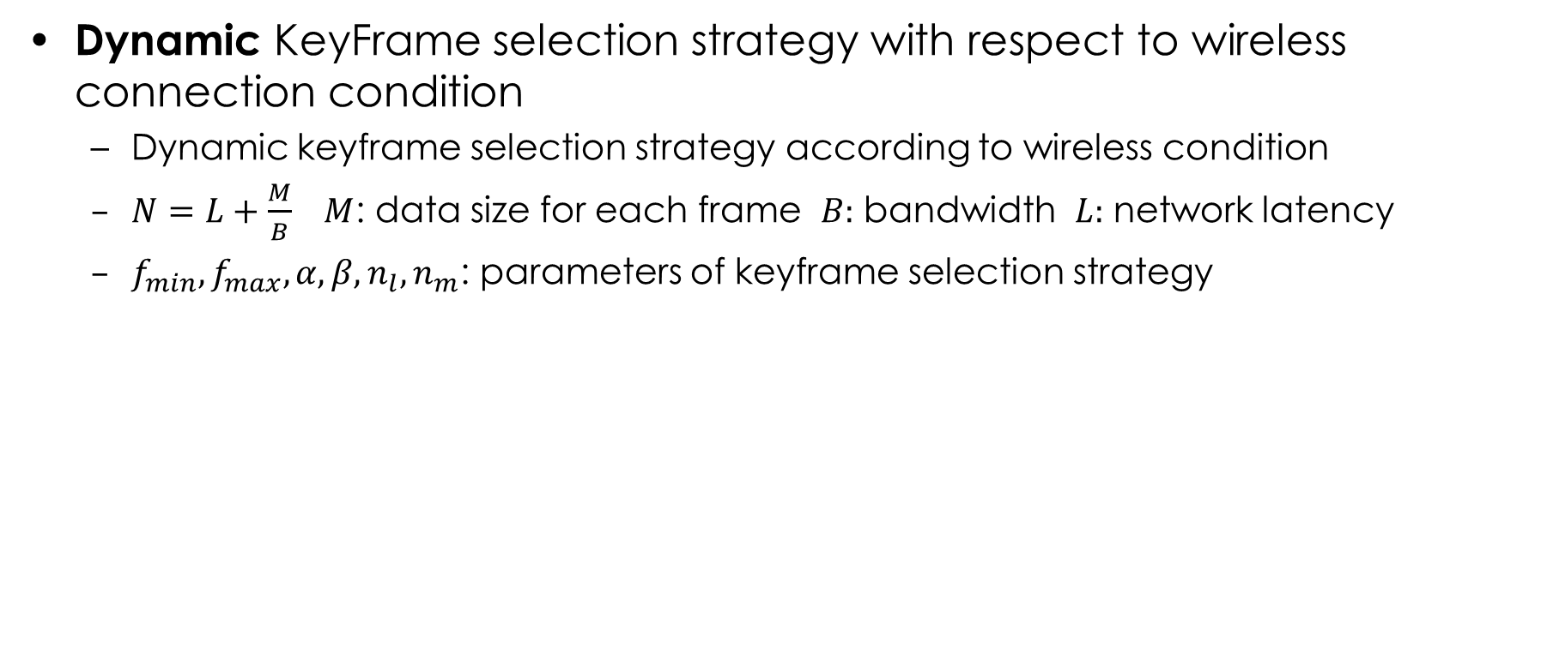
Our System
Dynamic KeyFrame selection strategy with respect to wireless connection condition
Dynamic keyframe selection strategy according to wireless condition
$N=L+\frac{M}{B}$ $M$: data size for each frame $B:$ bandwidth $L:$ network latency
$f_{min},f_{max},α,β,n_{l},n_{m}$: parameters of keyframe selection strategy
Notes:
[START]We finally design a dynamic keyframe selection strategy. Only keyframe selected by mobile client will be uploaded to edge server for further optimization.
We define six essential hyper-parameters used for keyframe selection, and dynamic change these parameters with respect to the network condition.

Slide 16
Experiment
Experimental Scenarios
Two standard datasets: TUM[1] and KITTI[2]
Comparative methods:
original ORB SLAM: state-of-the-art SLAM framework
Mask-SLAM: simply fused Mask RCNN framework and SLAM, used in previous works.
Neither of above two methods can work on mobile devices, entire task are offloaded to edge server
Case study:
Pedestrian Localization and Tracking in a laboratory
Robot Mapping and Navigation in a shopping mall
Mobile devices:
Two Samsung Galaxy S10, two Google Nexus 6p
One iPhone X
One Nvidia Jetsion TX2 (a type of development board for edge computing)
[1] J. Sturm, N. Engelhard, F. Endres, W. Burgard, and D. Cremers, “A benchmark for the evaluation of rgb-d slam systems,” in Proceedings of the IEEE IROS, 2012.
[2] A. Geiger, P. Lenz, and R. Urtasun, “Are we ready for autonomous driving? the kitti vision benchmark suite,” in Proceedings of the IEEE CVPR, 2012.
Notes:
[START] We prototype edgeSLAM on three kinds of smartphones and one Nvidia development board, and conduct experiments on two official SLAM datasets and in two real-world scenarios.
We compare edgeSLAM with two benchmarks, in the comparison, neither of the above two methods can work on mobile devices, the entire task of them are offloaded to edge server, so the localization bias introduced by transmission delay will be taken into consideration.

Slide 17
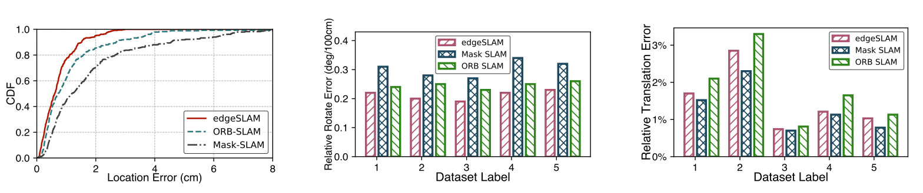
Experiment
Accuracy on dataset
Outperforms benchmarks by more than 20%
Only the proposed edgeSLAM can work on mobile devices in real-time
Localization accuracy on TUM dataset
Tracking accuracy on KITTI dataset
Mapping accuracy on KITTI dataset
Notes:
[START] Let us first get a glimpse of the results on official dataset.
edgeSLAM outperforms benchmarks by more than 20%.
More specially, only edgeSLAM can work in real-time.

Slide 18
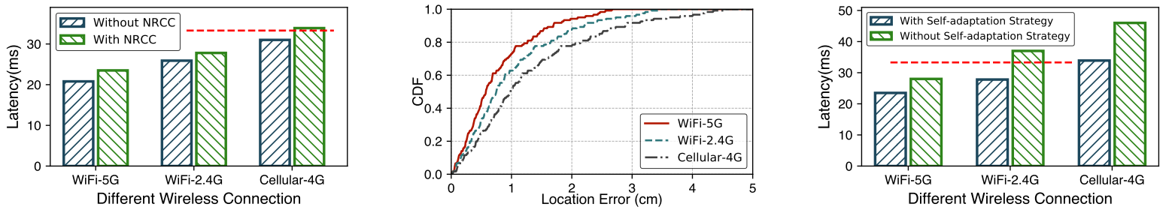
Experiment
End-to-end latency under different wireless connection
Although fused with Segmentation framework, edgeSLAM can still work in real-time (>30 fps)
With dynamic hyper-parameters selection strategy, edgeSLAM can handle different wireless connection condition
Indicates 30 fps
Notes:
[START] Our system is able to achieve an end-to-end latency within 33.3ms inter-frame time at 30fps to ensure a smooth localization and mapping experience. To validate this, we run edgeSLAM under differnet network connections and calculate the average end-to-end latency for each frame.
As shown in the figures, the red dashed line in the figure is the 33.3ms deadline for 30fps SLAM devices. We can find that our system is able to finish the entire task within 33.3ms under the majority wireless connection conditions.
[CLICK]And with the dynamic keyframe selection strategy, the latency delay decrease more than 10%.

Slide 19
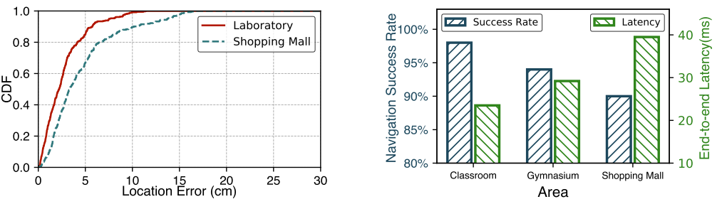
Experiment
Results on case study
Average:7.6cm
95th: 9.9cm
Average:9.9cm
95th: 11.4cm
Pedestrian Tracking Accuracy
Robot Navigation Accuracy & Operation Delay
Notes:
[START] We finally conduct two case study to evaluate the performance of edgeSLAM in real-world scenarios.
We collect surveillance video frames and manually labeled the groundtruth,
As shown, in shopping mall and laboratory, the average localization accuracy of edgeSLAM are within 10cm.
And the navigation success rate for a robot equipped with edgeSLAM are more than 90%.
Additionally, the wireless connections are different in three areas. In classroom building, client are connected to edge server under WiFi-5G link, while in gym and shopping mall are WiFi-2.4G and Cellular-4G, respectively.
H, the end-to-end latency are within in 40ms, which demonstrate edgeSLAM can also work in real-time.

Slide 20
Conclusion & Contribution
We designed edgeSLAM, an edge assisted framework to operate semantic visual SLAM. To the best of our knowledge, this is the first time that mobile semantic visual SLAM can work in real-time
We measured the operation time and memory overhead of each function module in visual SLAM and semantic segmentation, and ascertained the optimal decoupling position and disassembly method.
We take network condition into consideration and adopt an adaptive method to dynamically adjust system parameters.
We implement a complete edge assisted real-time system on smartphones and extensively evaluate the performance. The results show that edgeSLAM achieves delightful results in all scenarios.
Notes:
This is a summary of our work.

Slide 21
Thanks!
Q&A
Jingao Xu
Tsinghua University
xujingao13@gmail.com

